Slide 1
Model Selection

Slide 2
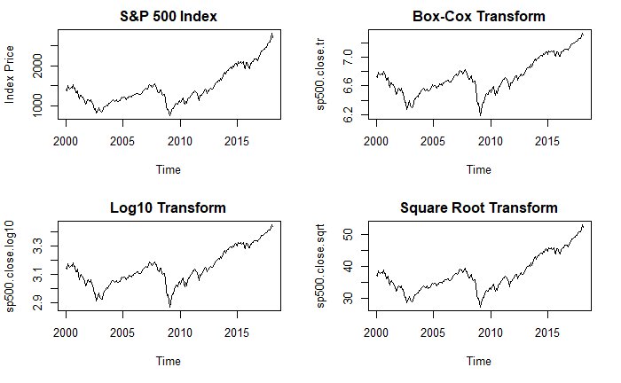
Data Transforms

Slide 3
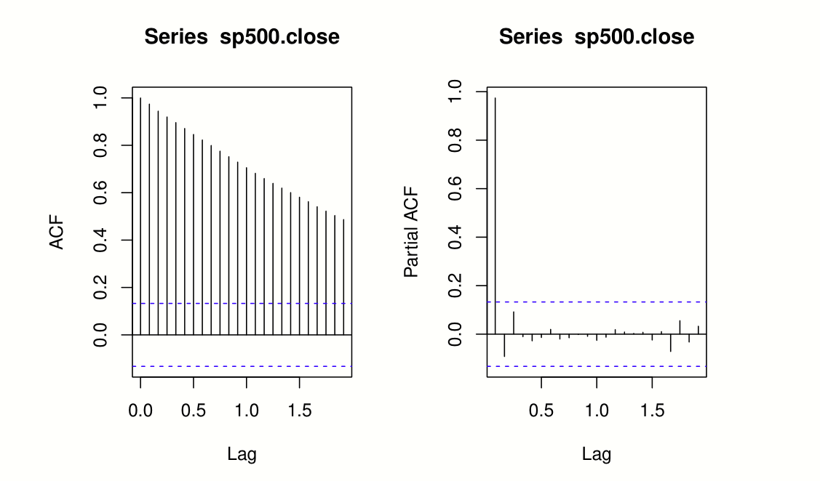
ACF and PACF

Slide 4
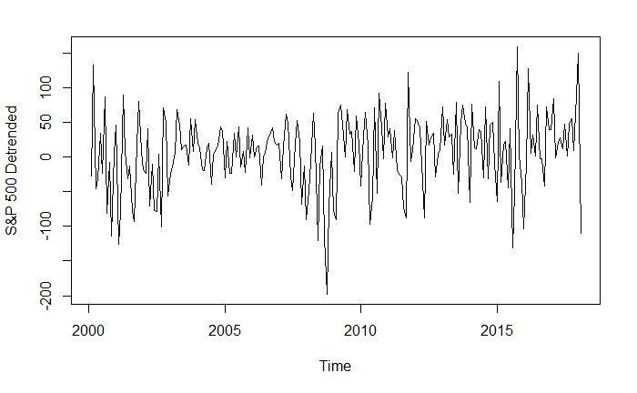
Lag 1 Difference

Slide 5
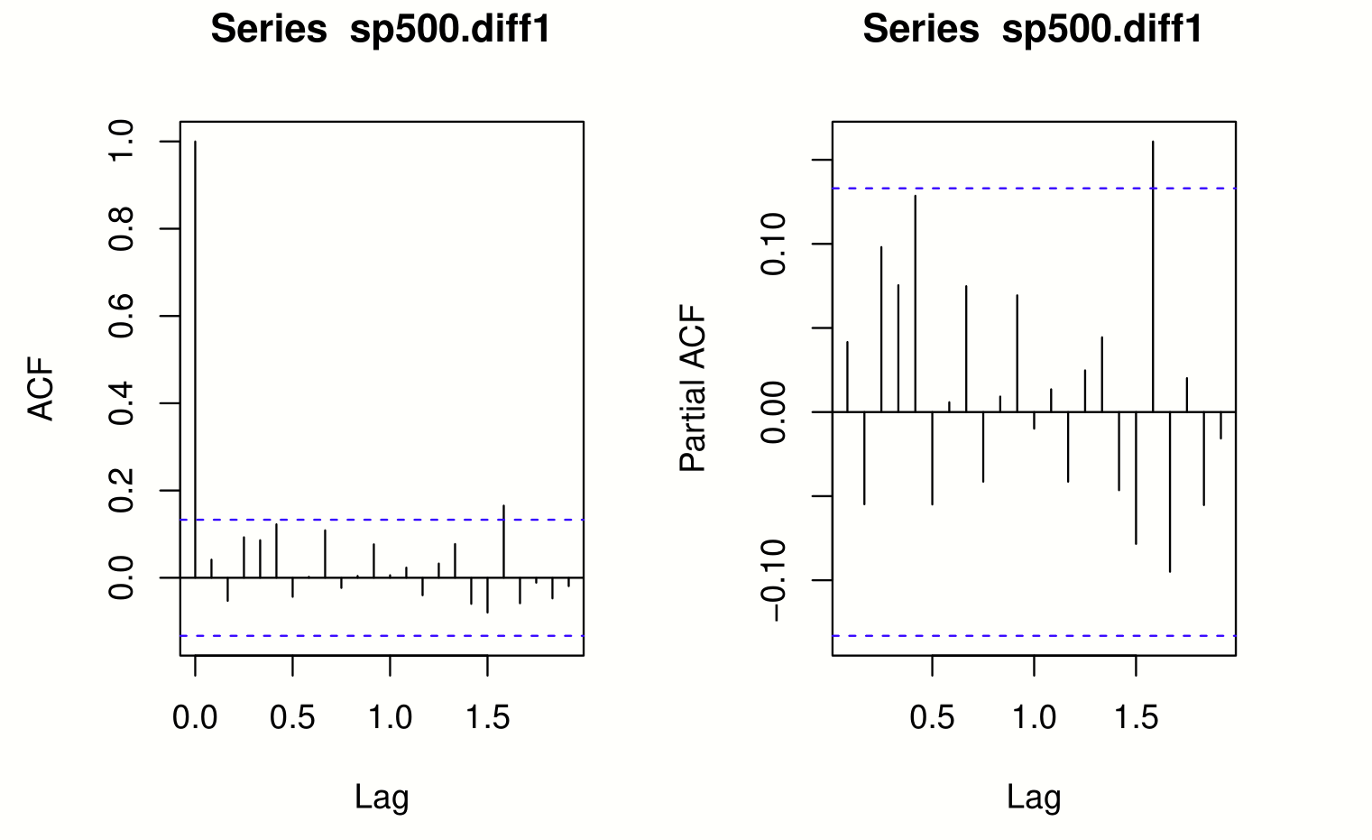
Differenced ACF and PACF

Slide 6
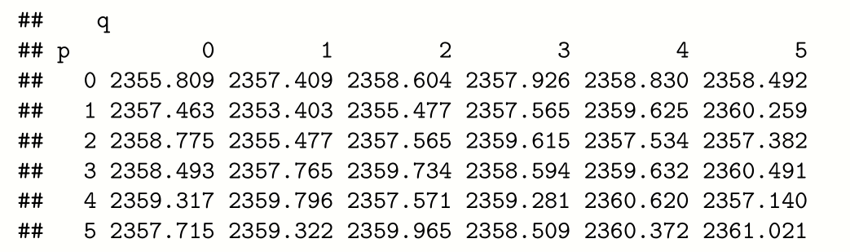
ARMA(P,Q) AICc Matrix

Slide 7
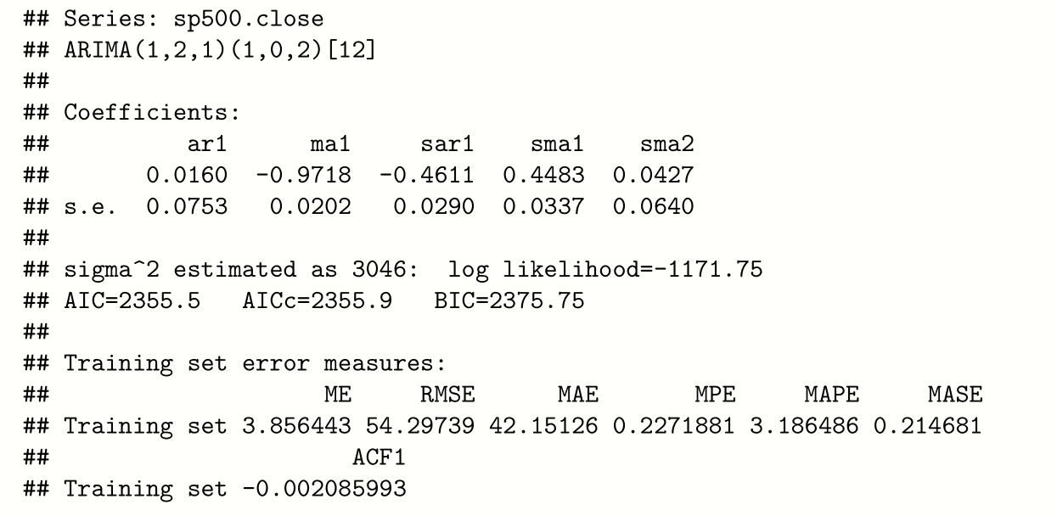
Auto.arima

